Slide 1
BEFORD'S LAW THROUGH TWITTER DATASET
TEAM - AURA
Leader - Raman Pandey
Member 2 - Manthan Subhash Ziman
Member 3 - Uzair Ahmed Shah
Member 4 - Jagadish Ishwar Patil

Slide 2
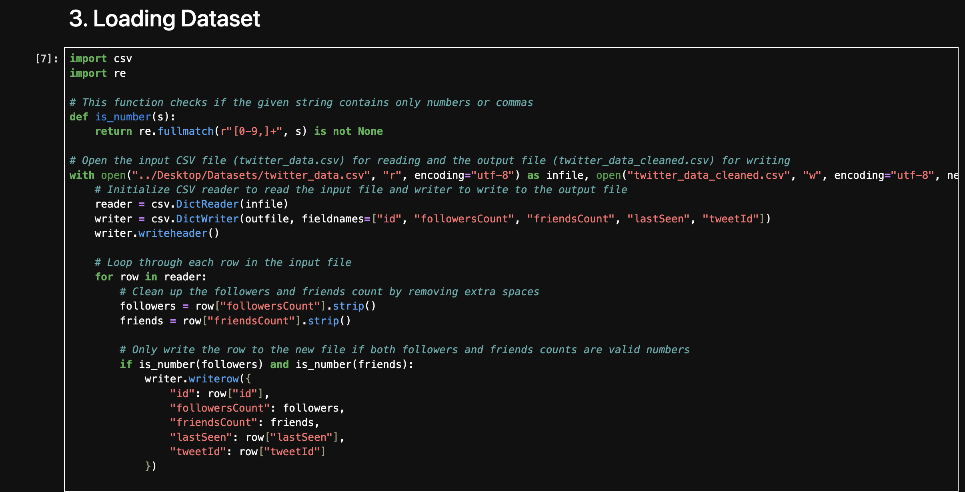
Raman Pandey
This Python script is designed to clean and filter Twitter user data stored in a CSV file.
The goal is to keep only records that contain valid numerical values for follower and friend counts.
The process involves reading raw data from a CSV file.
It checks if the relevant fields ( followersCount and friendsCount ) contain proper numeric values.
Only the clean and valid entries are written into a new CSV file.
This step is typically part of a data preparation process to ensure data quality before further analysis or use.

Slide 3
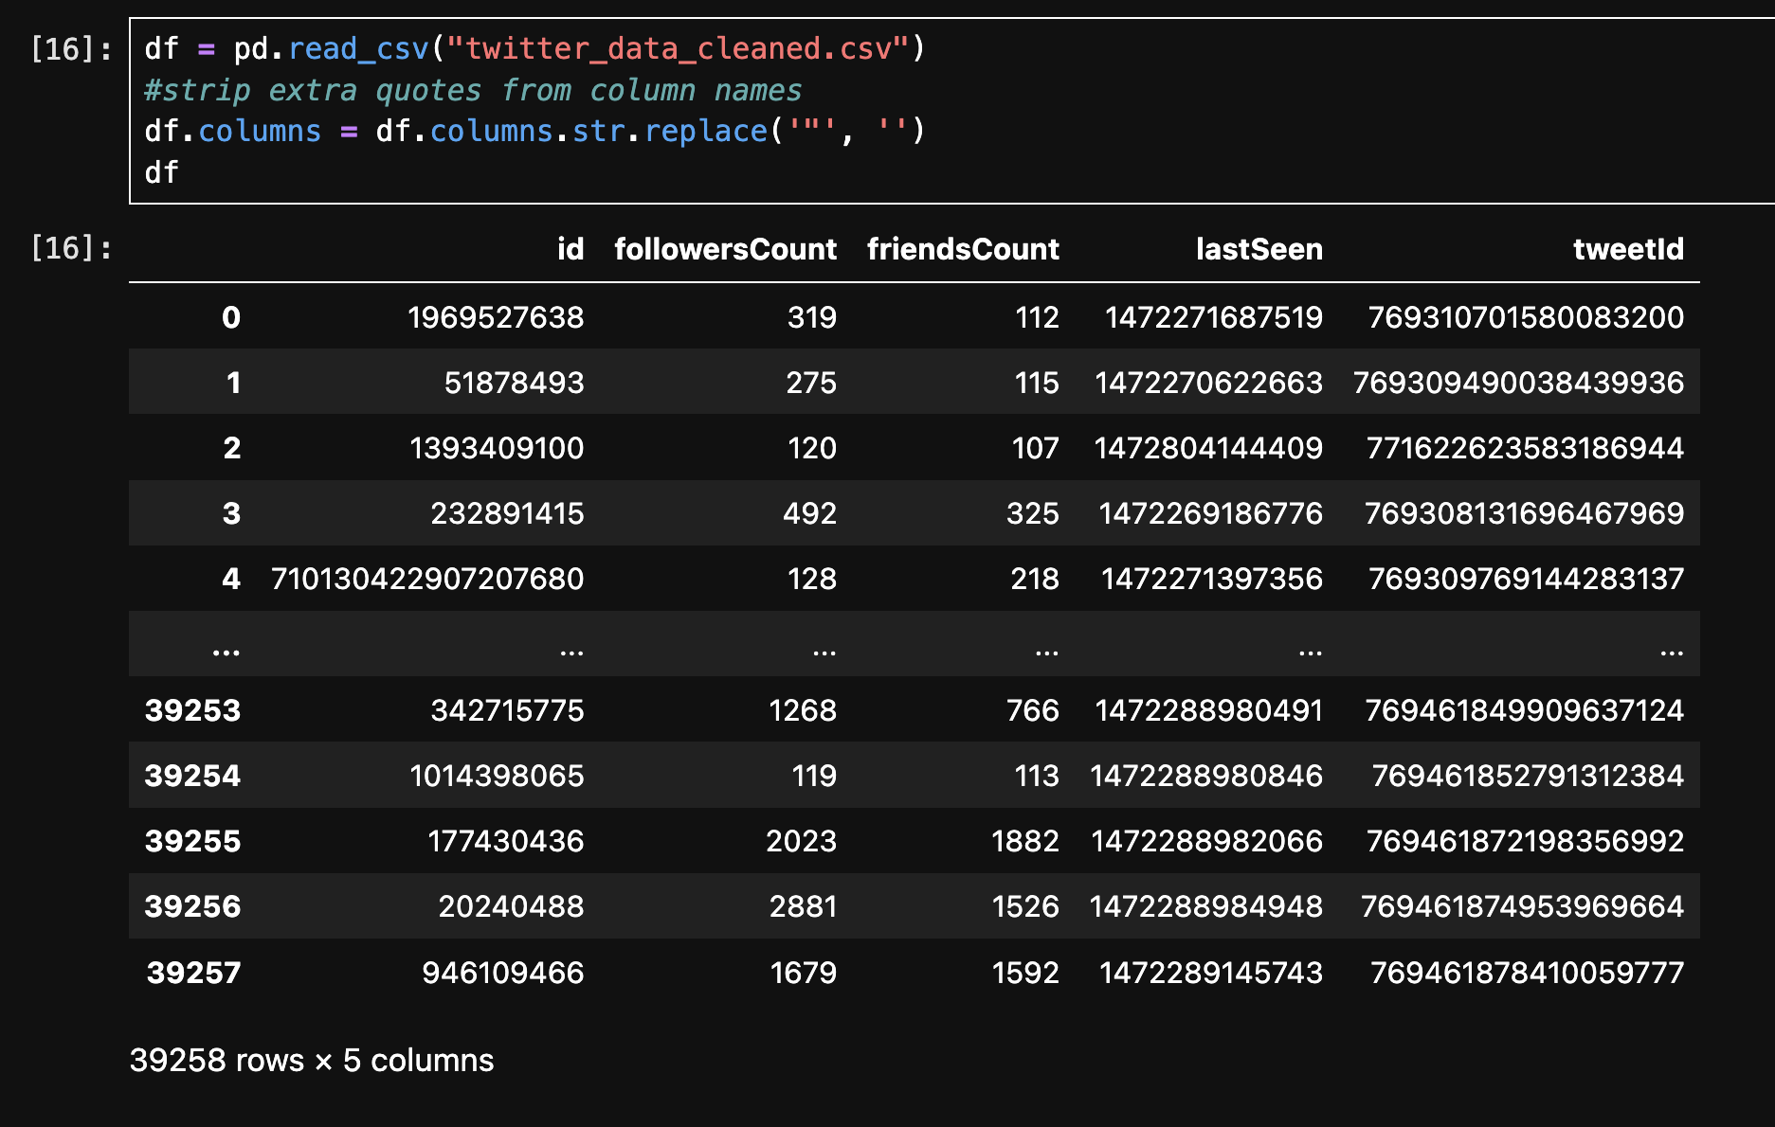
The script reads a cleaned Twitter data CSV file into a pandas DataFrame.
It then displays the content of the DataFrame, which includes Twitter user details such as:
id: The user's unique identifier.
followersCount: The number of followers.
friendsCount: The number of people the user follows.
lastSeen: The timestamp of the user's last activity.
tweetId: The identifier of the most recent tweet.
This step is to ensure that the structure and formatting of the dataset are correct before analysis.

Slide 4
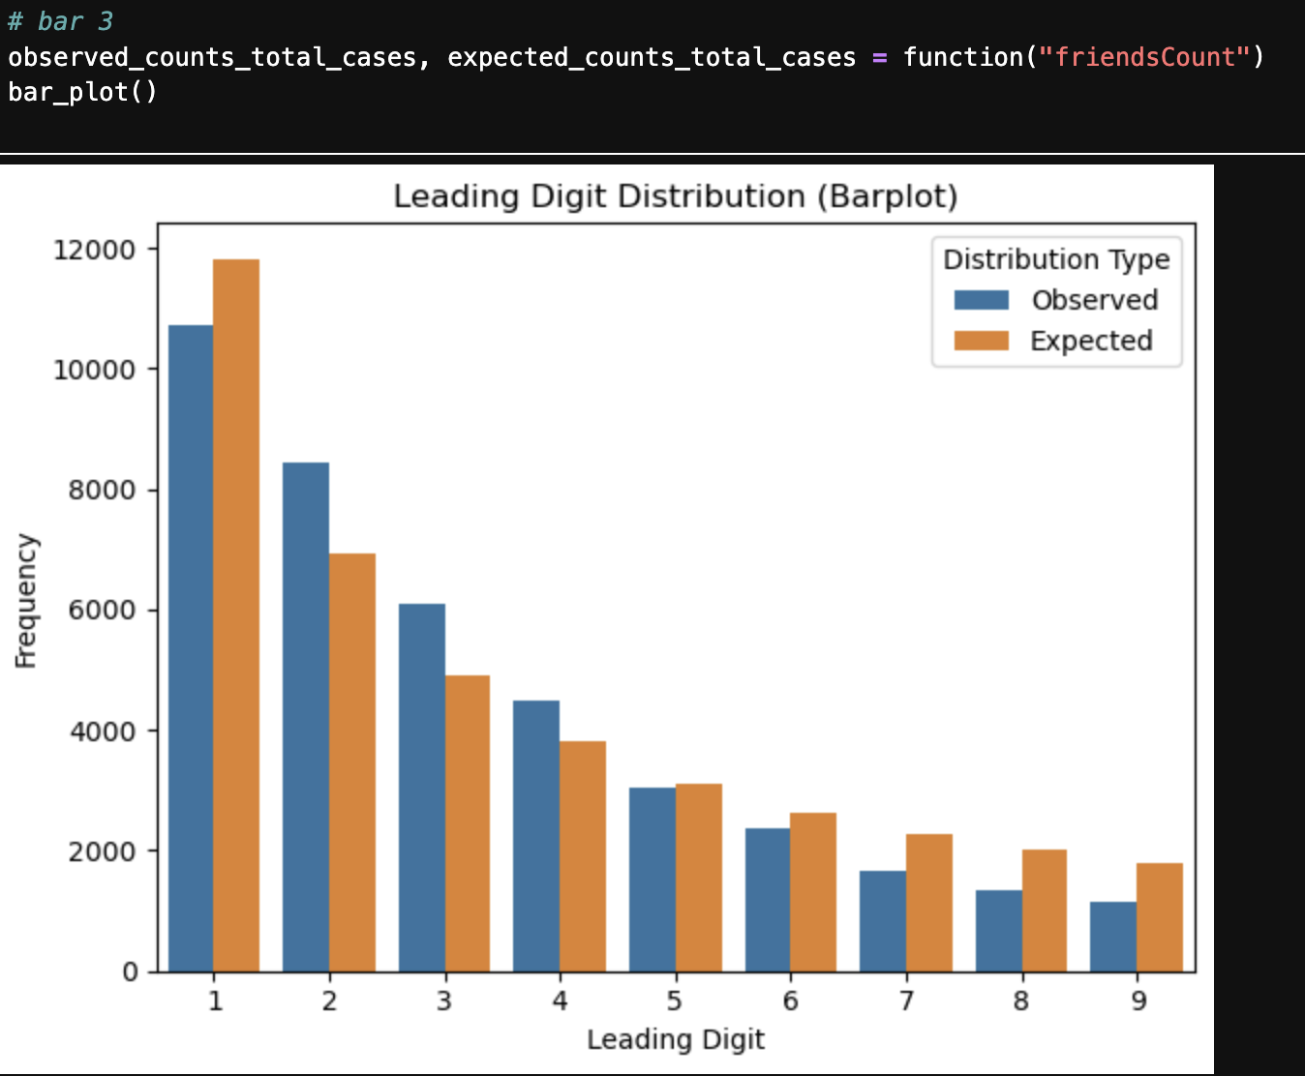
Uzair Ahmed Shah​
Visualises and analyses some field in twitter data and draw conclusion on Benford's Law
The code compares the actual vs. expected distribution of friendsCount values and uses a bar chart to visualize any differences or patterns.
Conclusion - The observed distribution closely follows Benford's Law, with only minor fluctuations. Overall, the graph exhibits a similar pattern to the expected distribution.

Slide 5
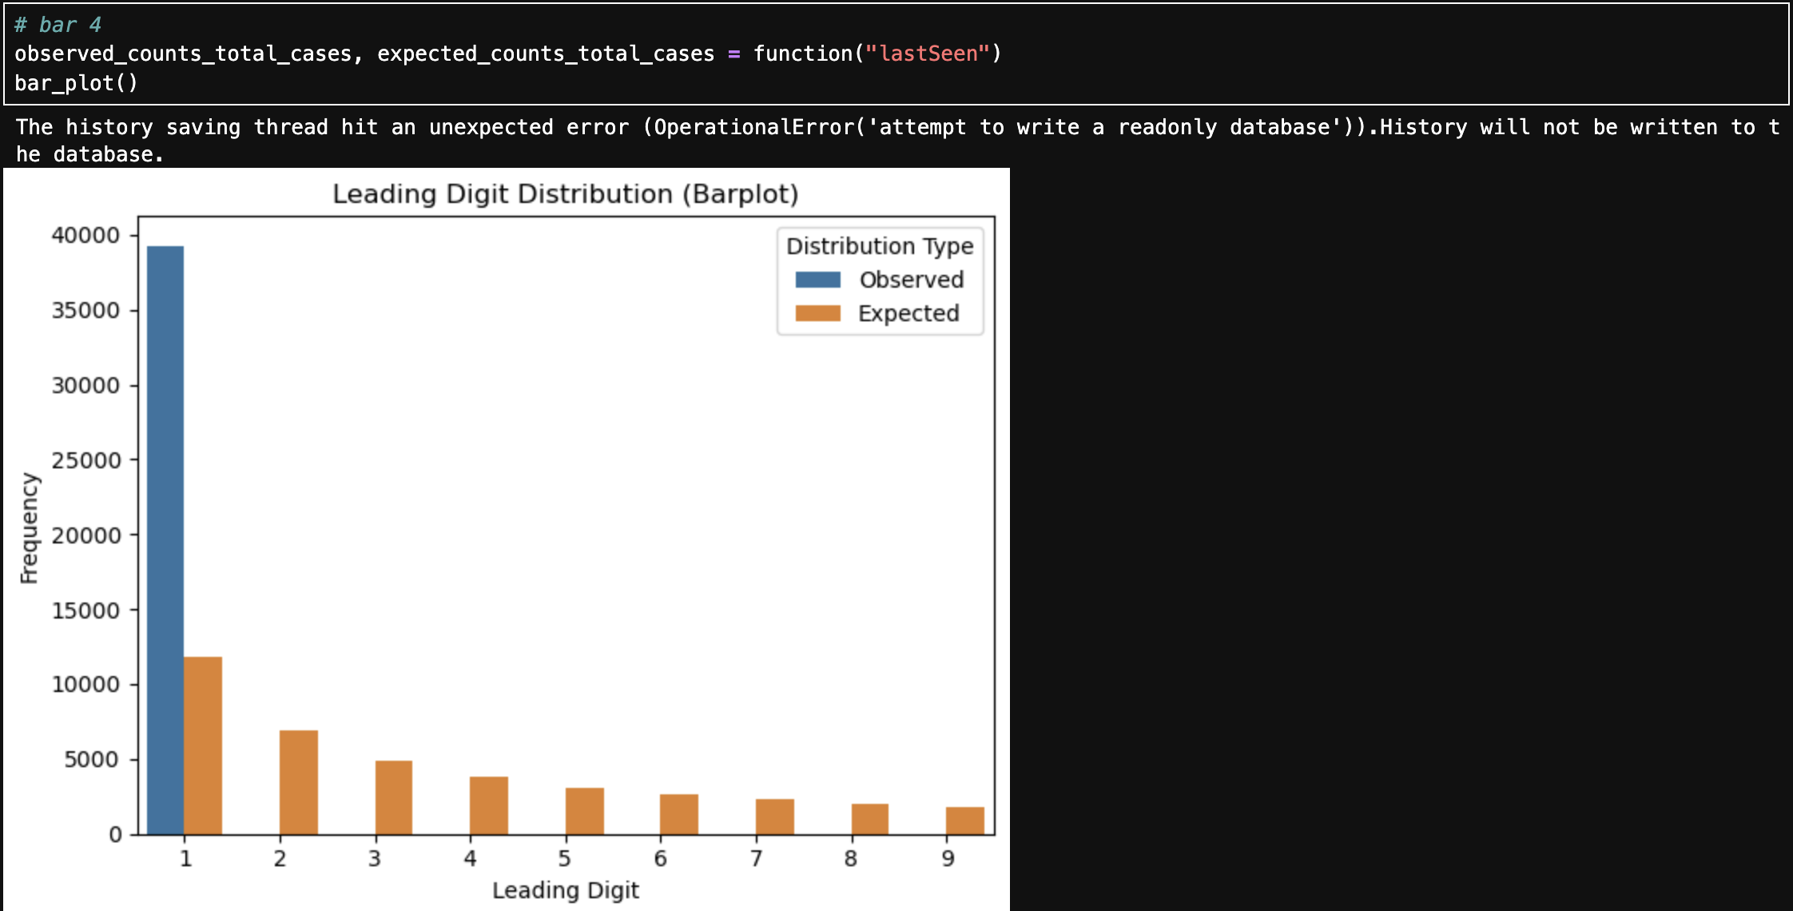
The code compares the actual vs. expected distribution of lastSeen values and uses a bar chart to visualize any differences or patterns.
Conclusion - The observed distribution does not follow Benford's Law, because the data is biased toward values having leading digit 1 .

Slide 6
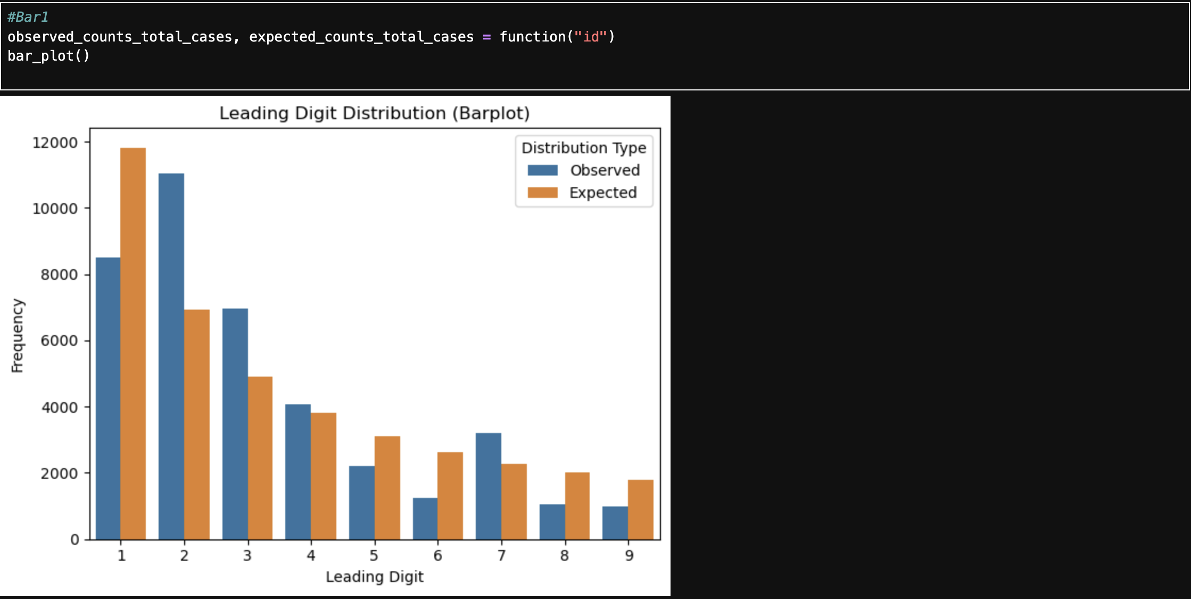
Jagadish Ishwar Patil
Visualises and analyses some field in twitter data and draw conclusion on Benford's Law
The code compares the actual vs. expected distribution of id values and uses a bar chart to visualize any differences or patterns.
Conclusion - The observed distribution follow Benford's Law closely , but
It is showing different at value '2' and '7' the frequency of the numbers with leading digit 2 and 7 are higher than expected .

Slide 7
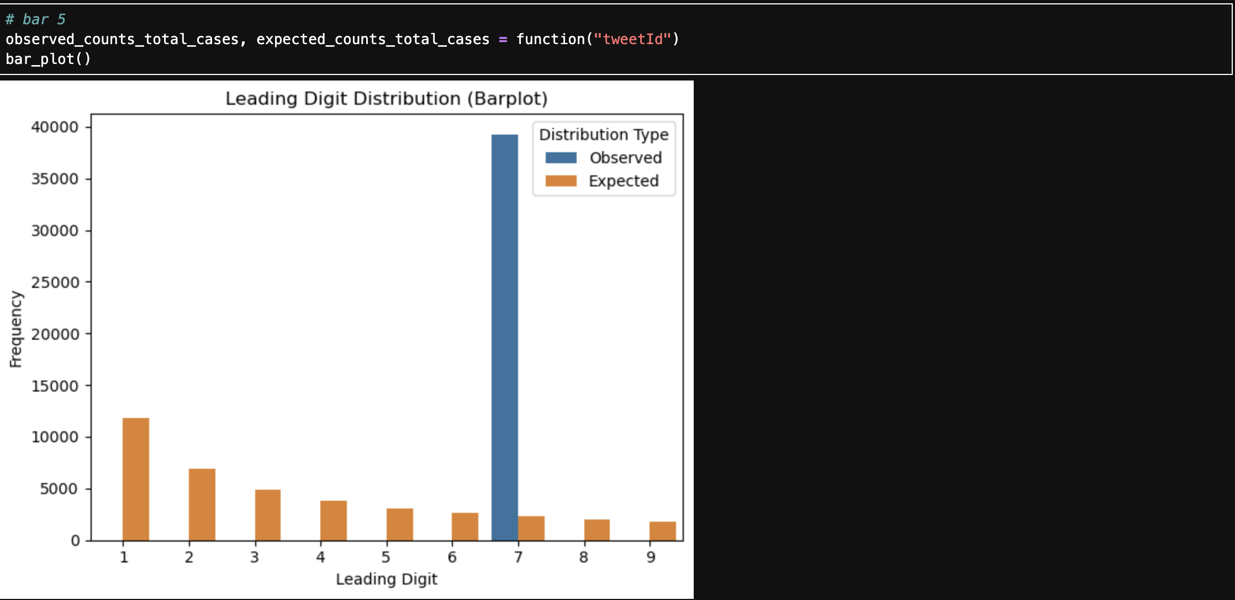
The code compares the actual vs. expected distribution of tweetid values and uses a bar chart to visualize any differences or patterns.​
​
Conclusion - Conclusion - The observed distribution does not follow Benford's Law, because the data is biased toward values having leading digit 7.

Slide 8
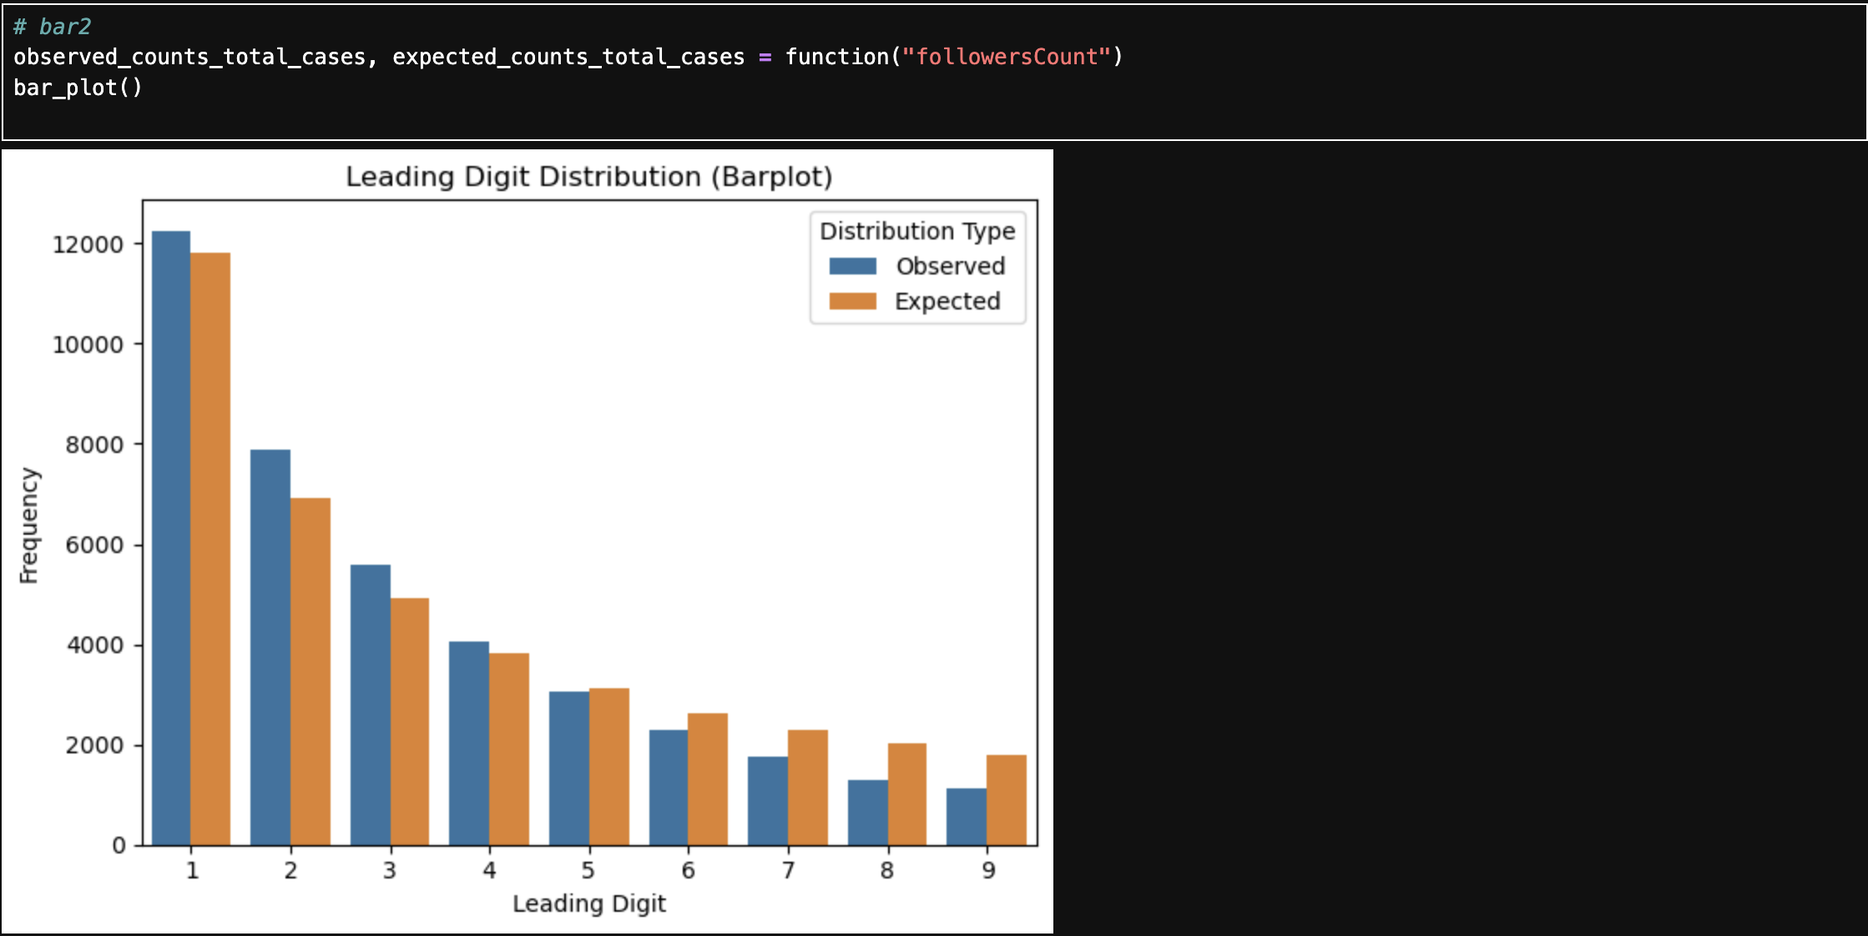
Manthan Subhash Ziman
Visualises and analyses some field in twitter data and draw conclusion on Benford's Law
Presentation
The code compares the actual vs. expected distribution of followersCount values and uses a bar chart to visualize any differences or patterns.​
​
​
Conclusion - The observed distribution perfectly follows Benford's Law, with only minor fluctuations. Overall, the graph exhibits a similar pattern to the expected distribution.​

Slide 9
Thank You

